Slide 1
Development of a Diagonal Isometric Tensor Network Algorithm
Masters thesis
Benjamin Sappler

Slide 2
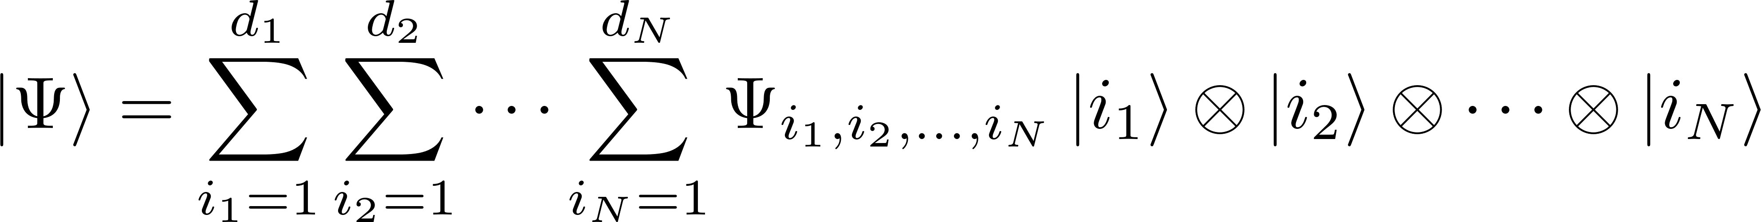
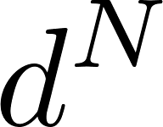
Simulation of QMB systems
parameters
Approximations are needed!

Slide 3
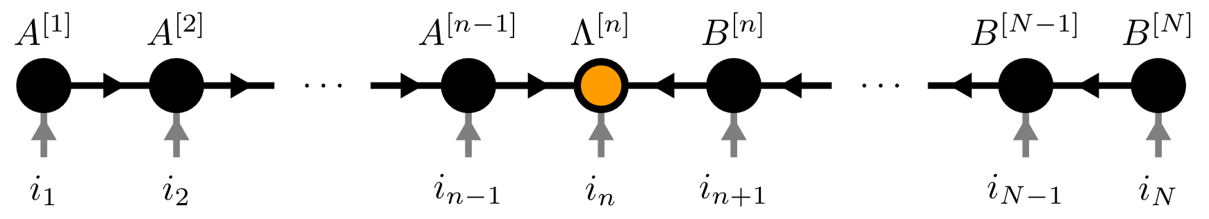
Contents
Matrix Product States (MPS)
Isometric Tensor Product States (isoTPS)
YB-isoTPS

Slide 4
Contents
Matrix Product States (MPS)
Isometric Tensor Product States (isoTPS)
YB-isoTPS

Slide 5

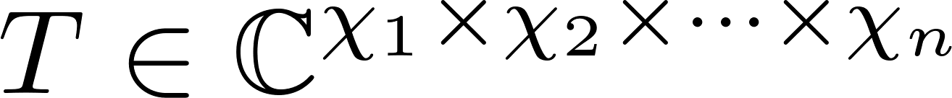
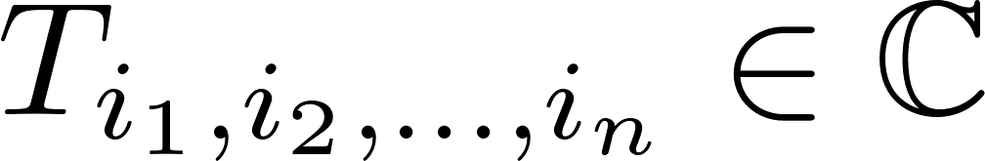
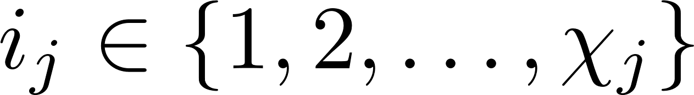
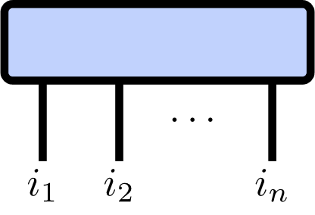
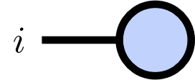
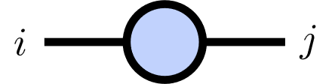
Tensor Networks
Tensor of rank :

Slide 6
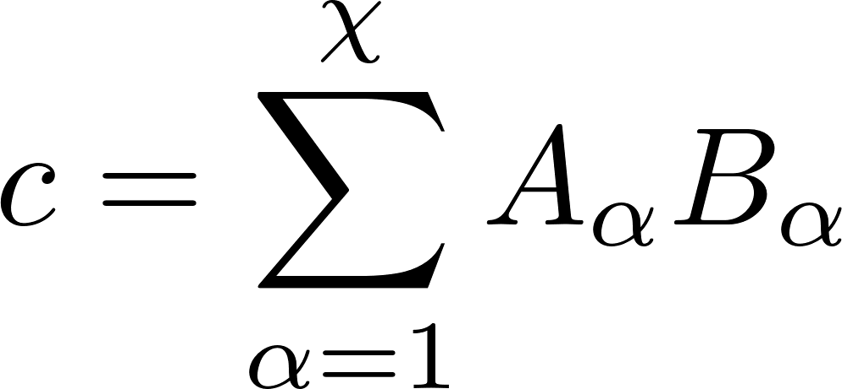
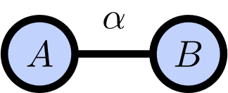
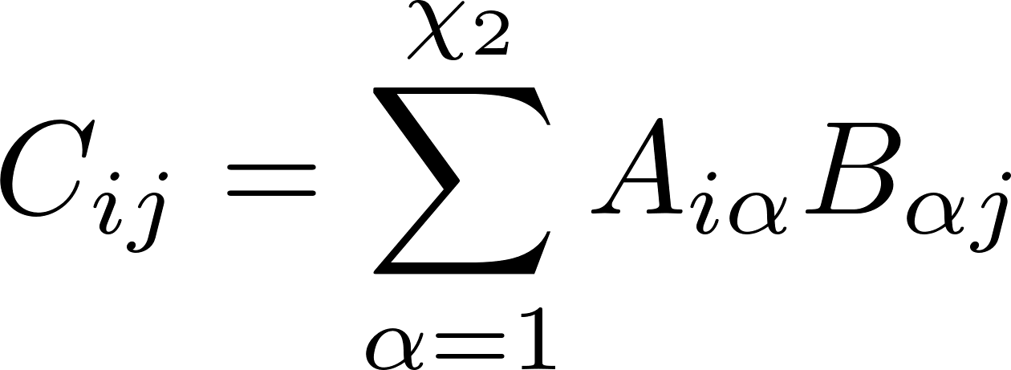
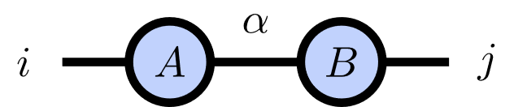
Index Contractions

Slide 7
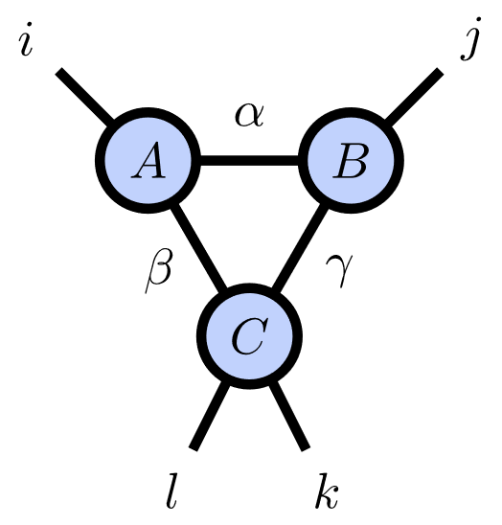
Index Contractions

Slide 8
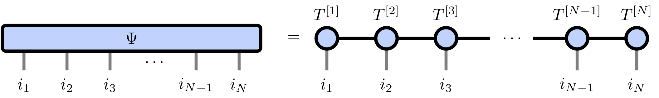
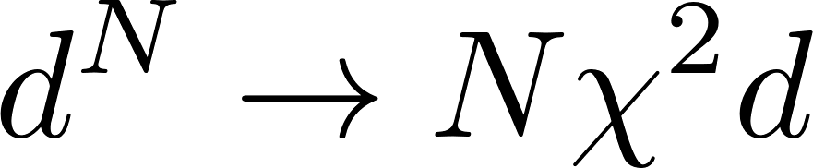
Matrix Product States
Number of parameters:

Slide 9

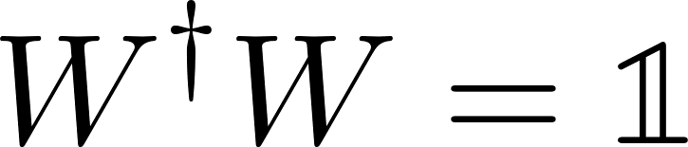
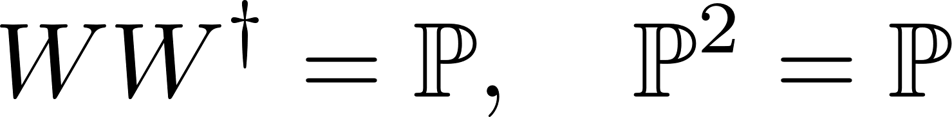
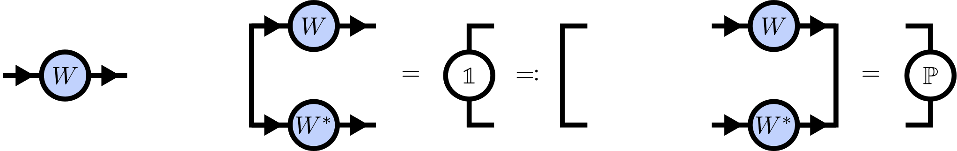
Isometries

Slide 10
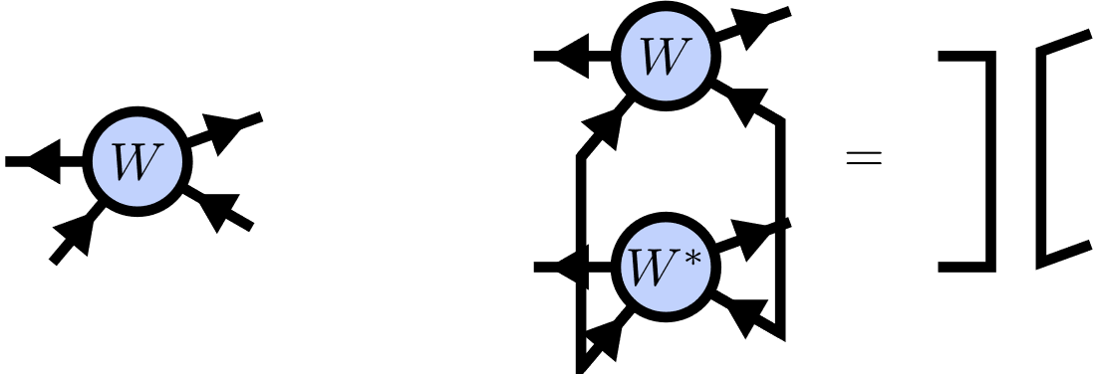
Isometric Tensors

Slide 11
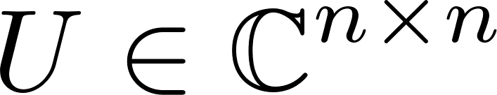
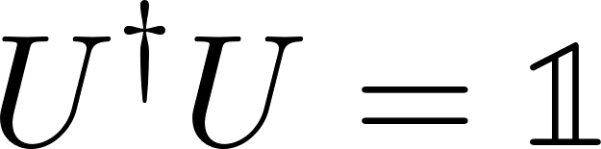
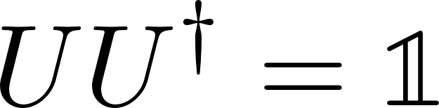
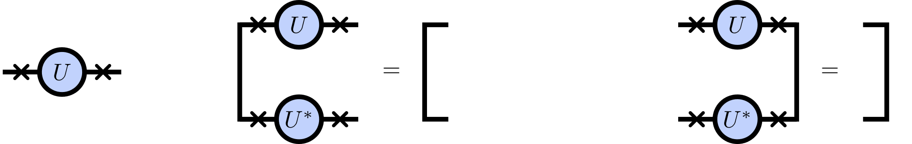
Unitaries

Slide 12
Canonical Form
TODO: Left/right isometry condition

Slide 13
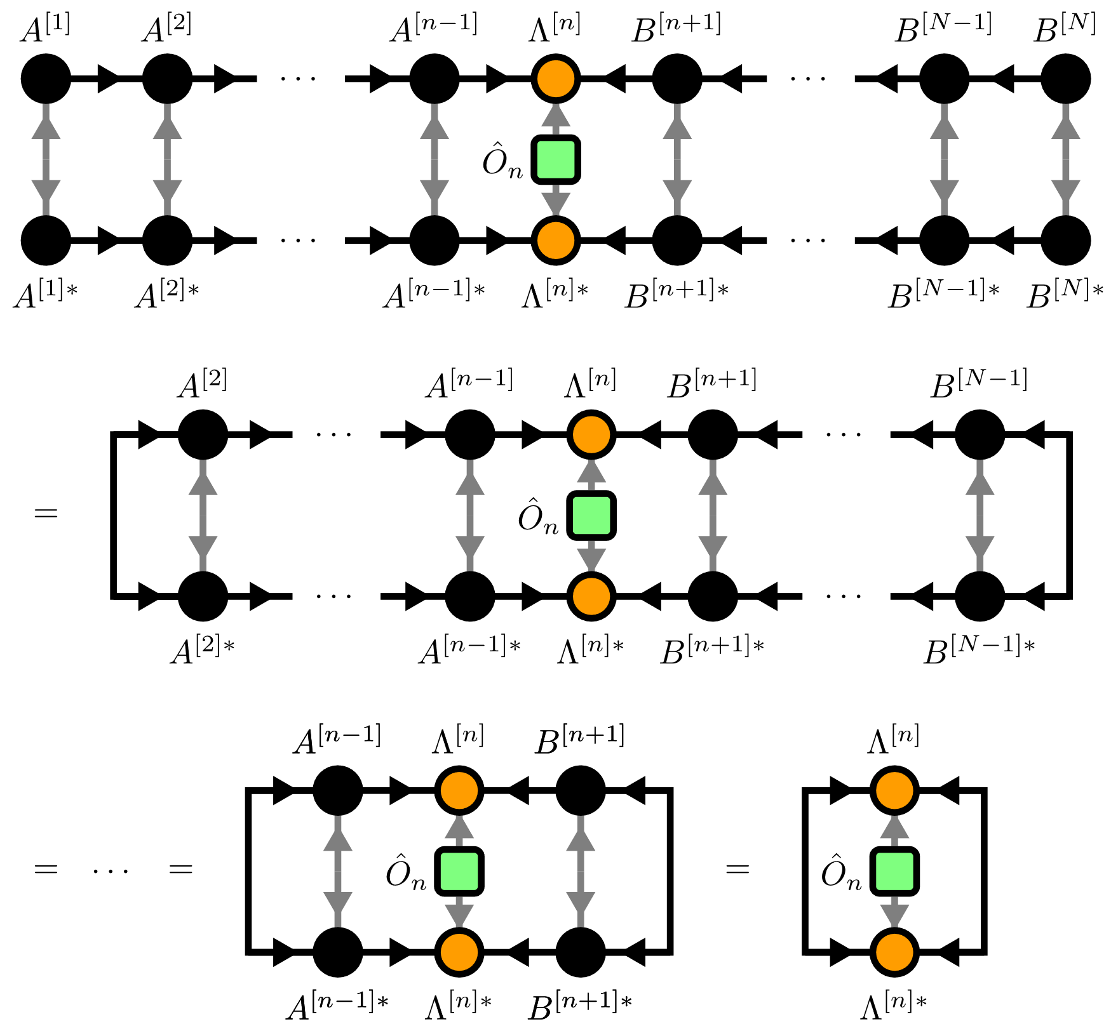
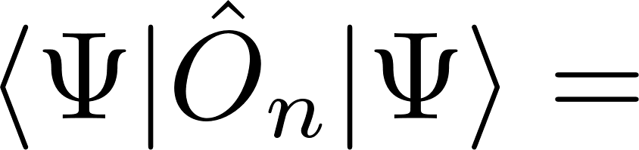
Local Expectation Values

Slide 14
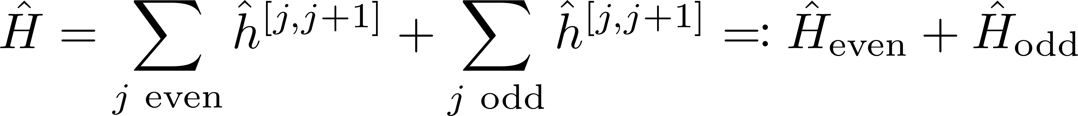
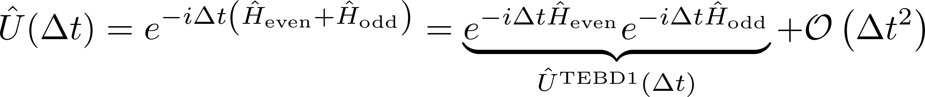
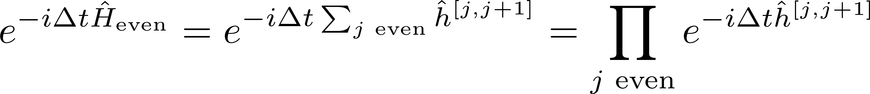
Time evolution

Slide 15
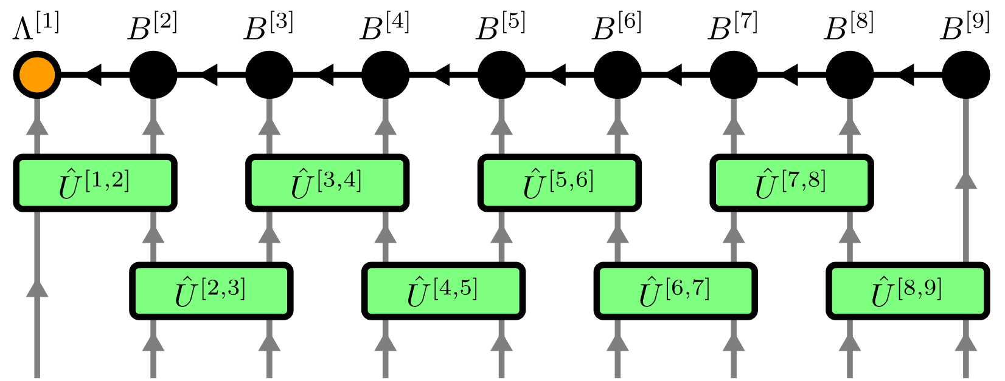
Time Evolving Block Decimation (TEBD)

Slide 16
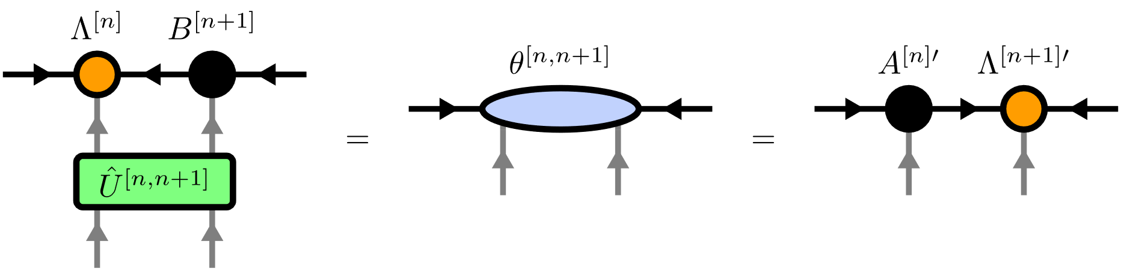
Time Evolving Block Decimation (TEBD)

Slide 17
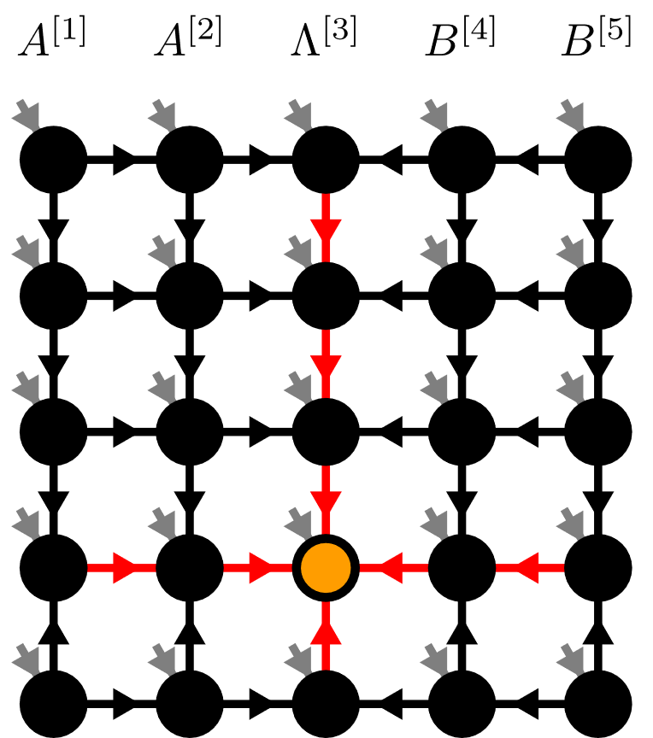
Contents
Matrix Product States (MPS)
Isometric Tensor Product States (isoTPS)
YB-isoTPS

Slide 18
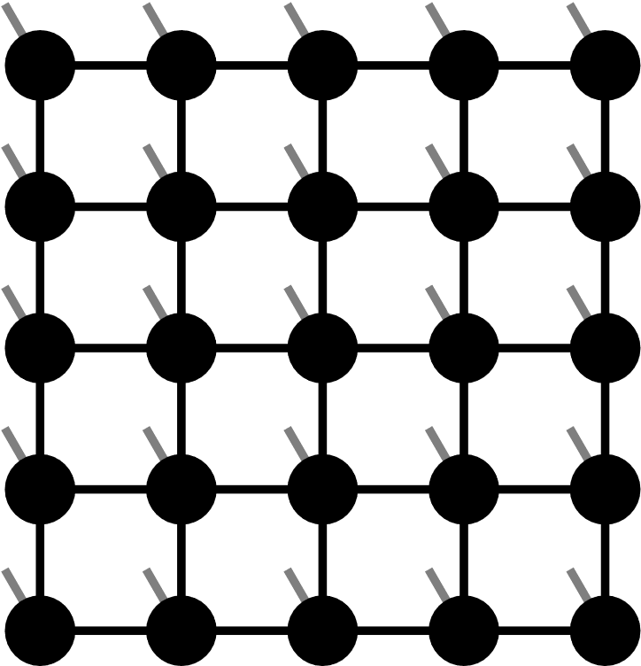
Projected Entangled Pair States (PEPS)

Slide 19
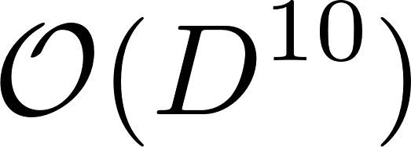
Projected Entangled Pair States (PEPS)
TEBD:

Slide 20
Isometric Tensor Product State

Slide 21
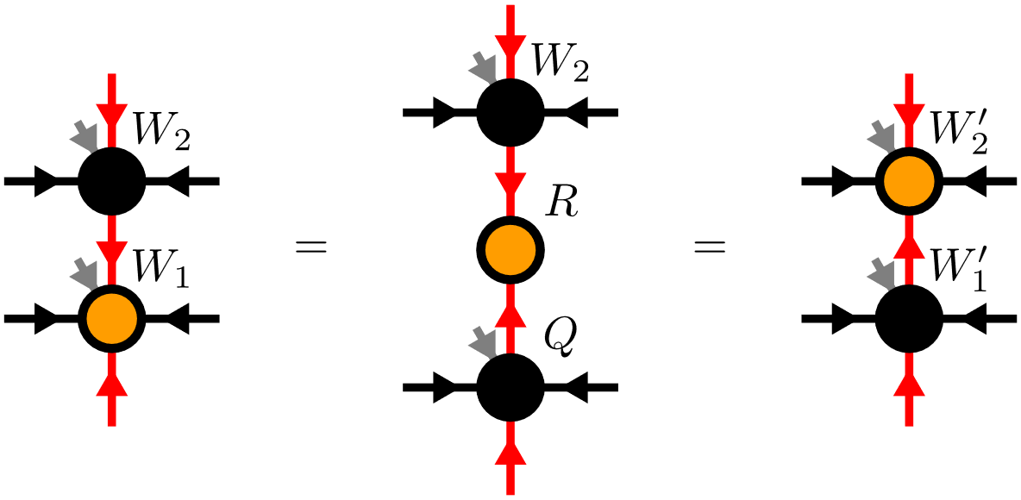
Moving the Orthogonality Center

Slide 22
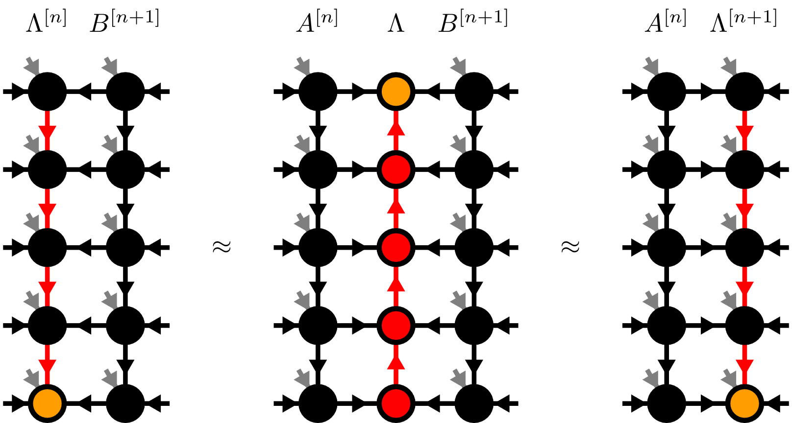
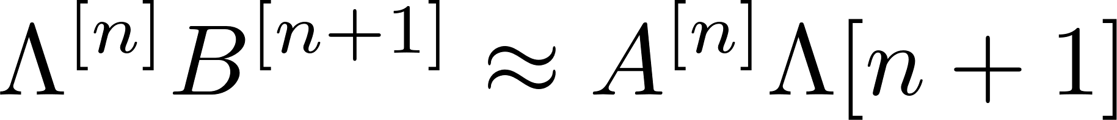
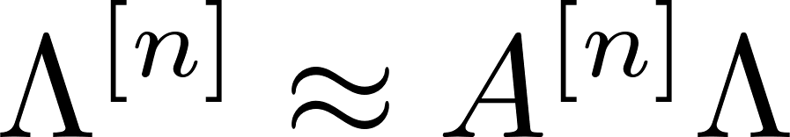

Moving the Orthogonality Hypersurface

Slide 23
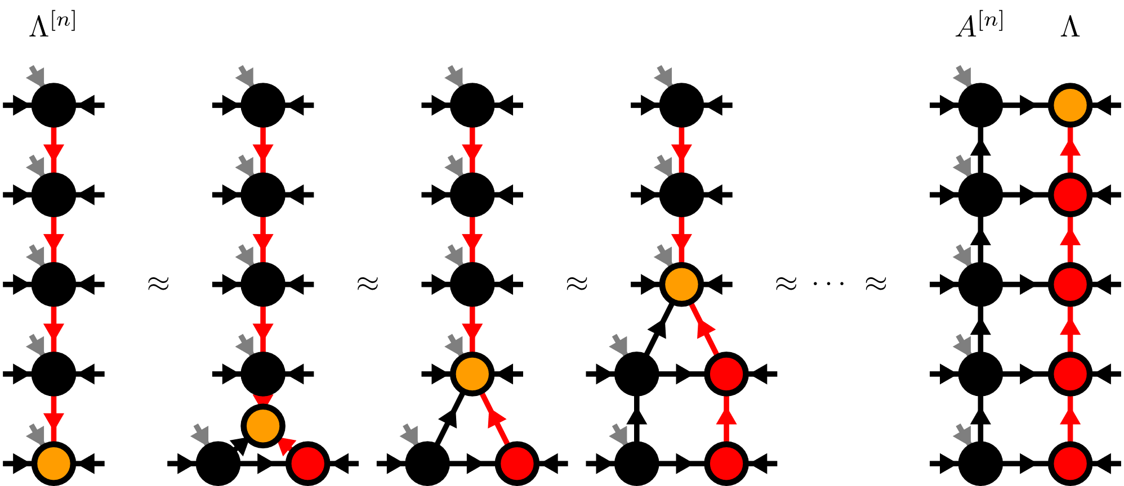
Moses-Move (MM)

Slide 24
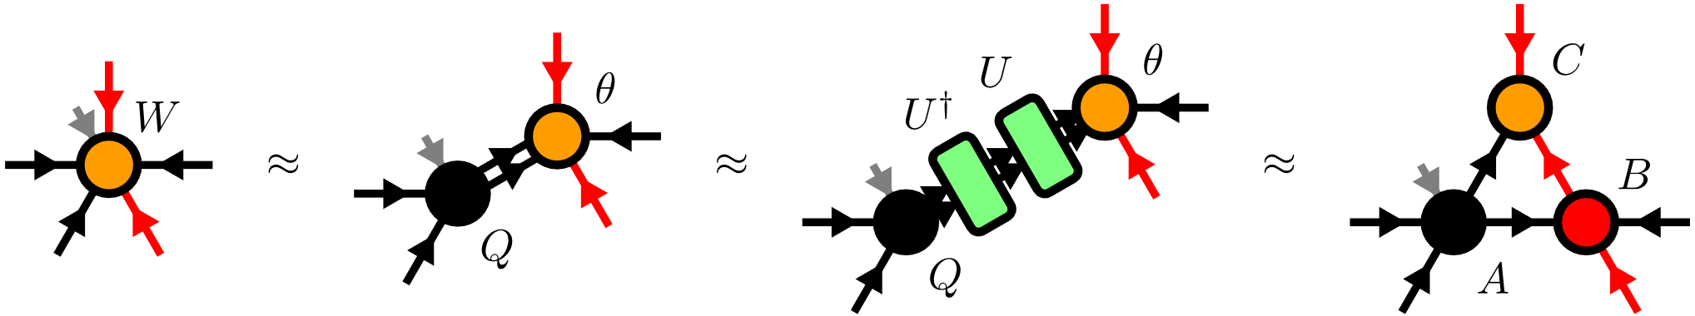
Moses-Move (MM) – Tripartite Decomposition

Slide 25
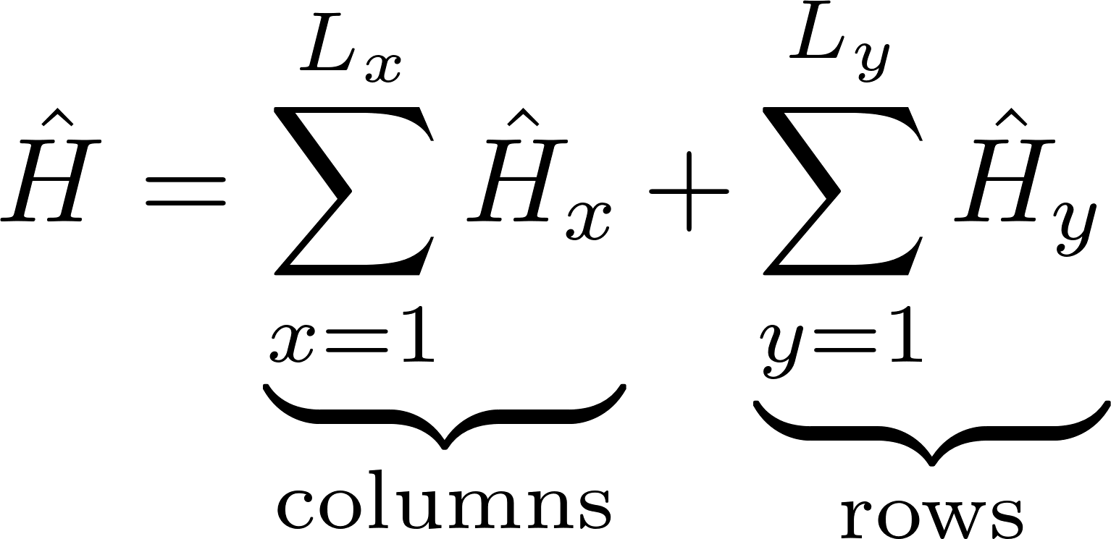
TEBD

Slide 26
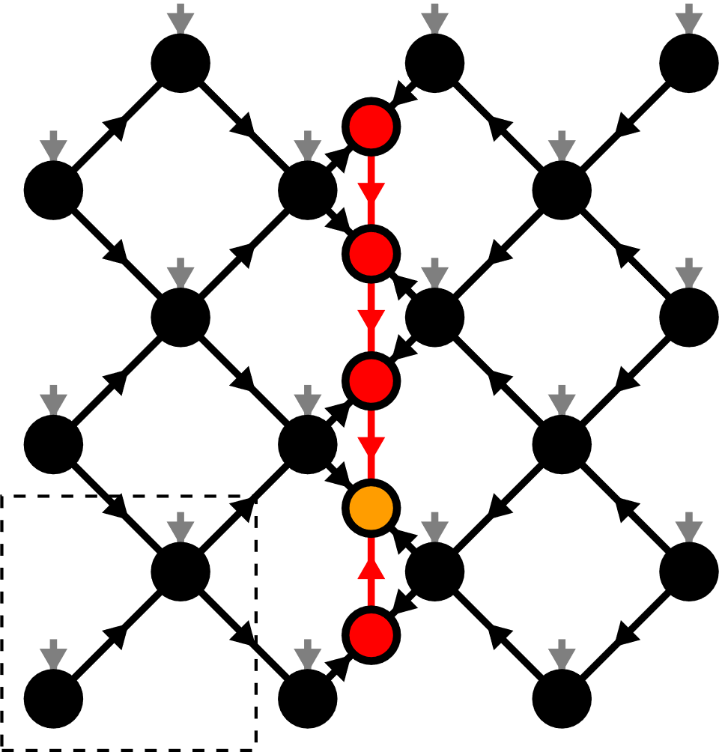
Contents
Matrix Product States (MPS)
Isometric Tensor Product States (isoTPS)
YB-isoTPS

Slide 27
YB-isoTPS

Slide 28
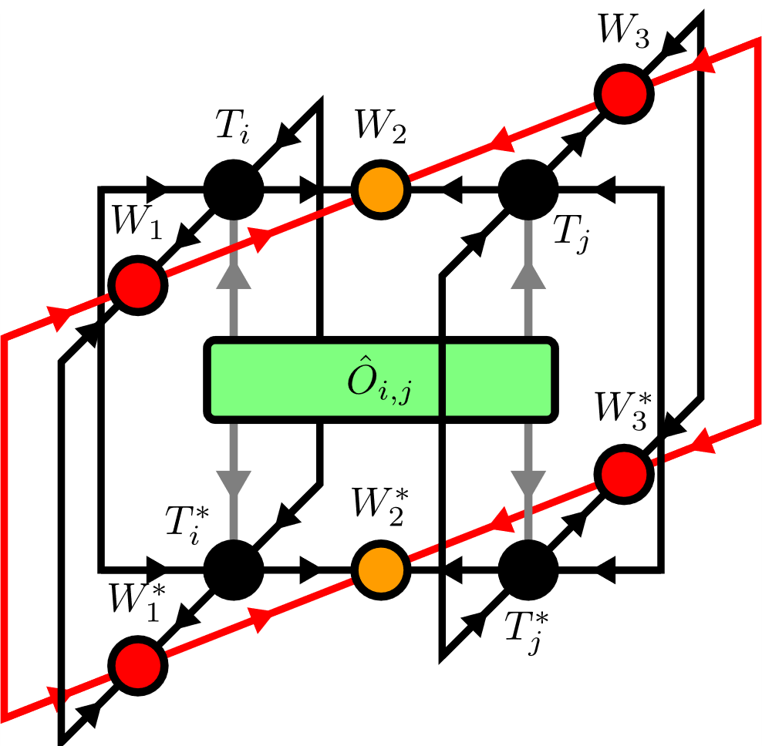
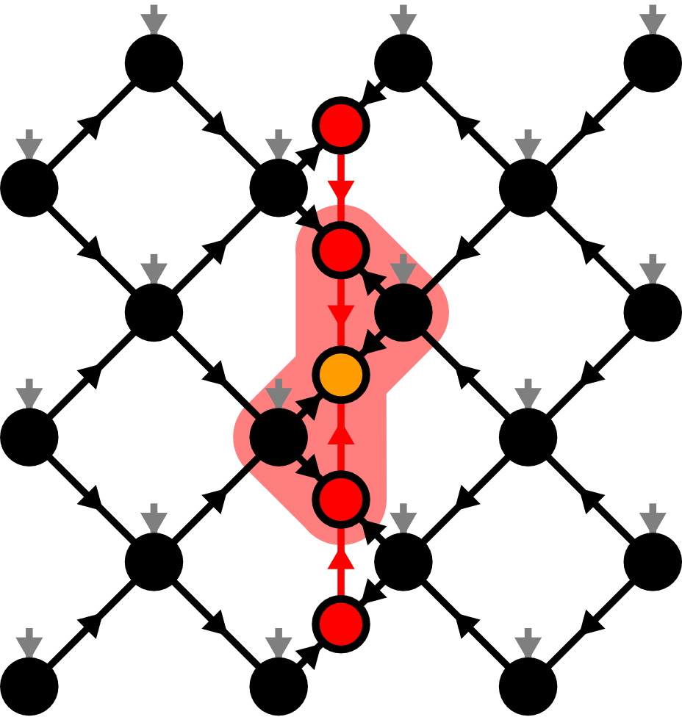
Local Expectation Values

Slide 29
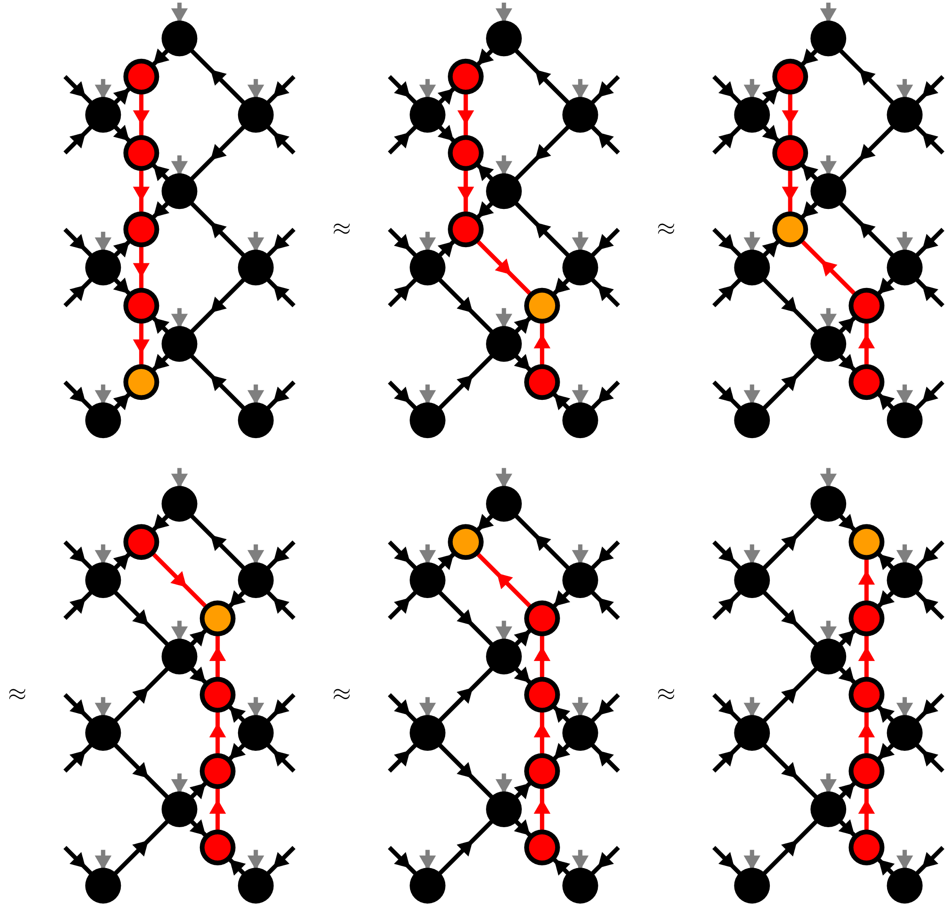
Moving the orthogonality hypersurface

Slide 30
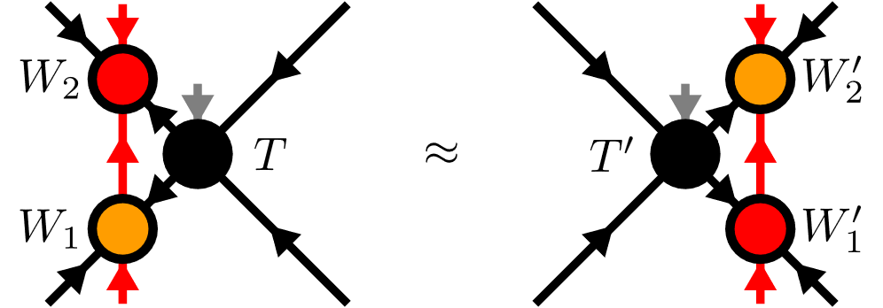
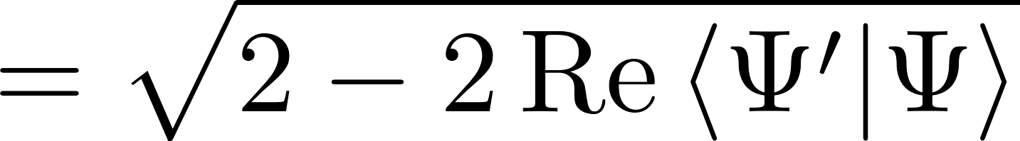
Yang-Baxter (YB) Move
YB Error

Slide 31
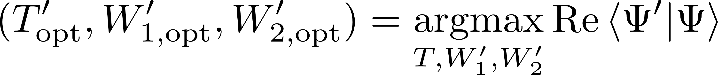
Yang-Baxter (YB) Move
Constrained optimization problem
Two algorithms:
Variational optimization with local updates
Tripartite decomposition using SVD + disentangling

Slide 32
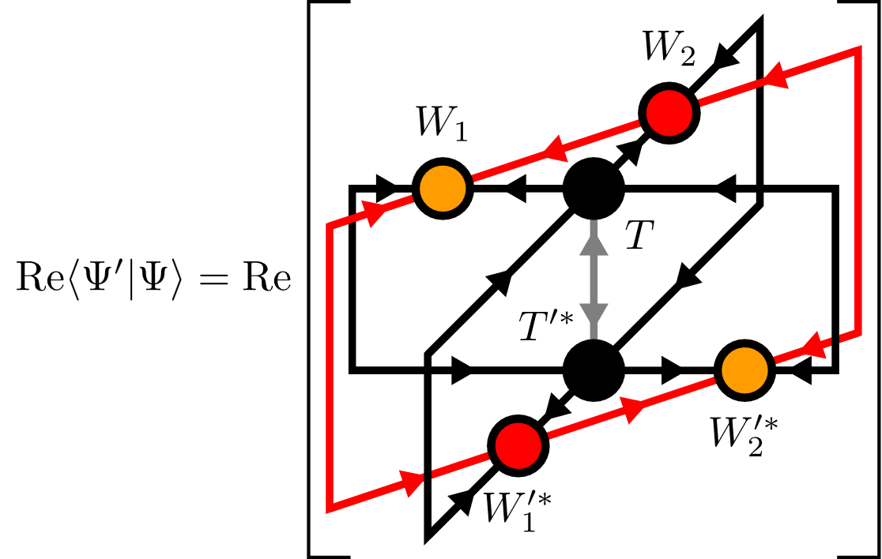
YB-move: Variational optimization

Slide 33
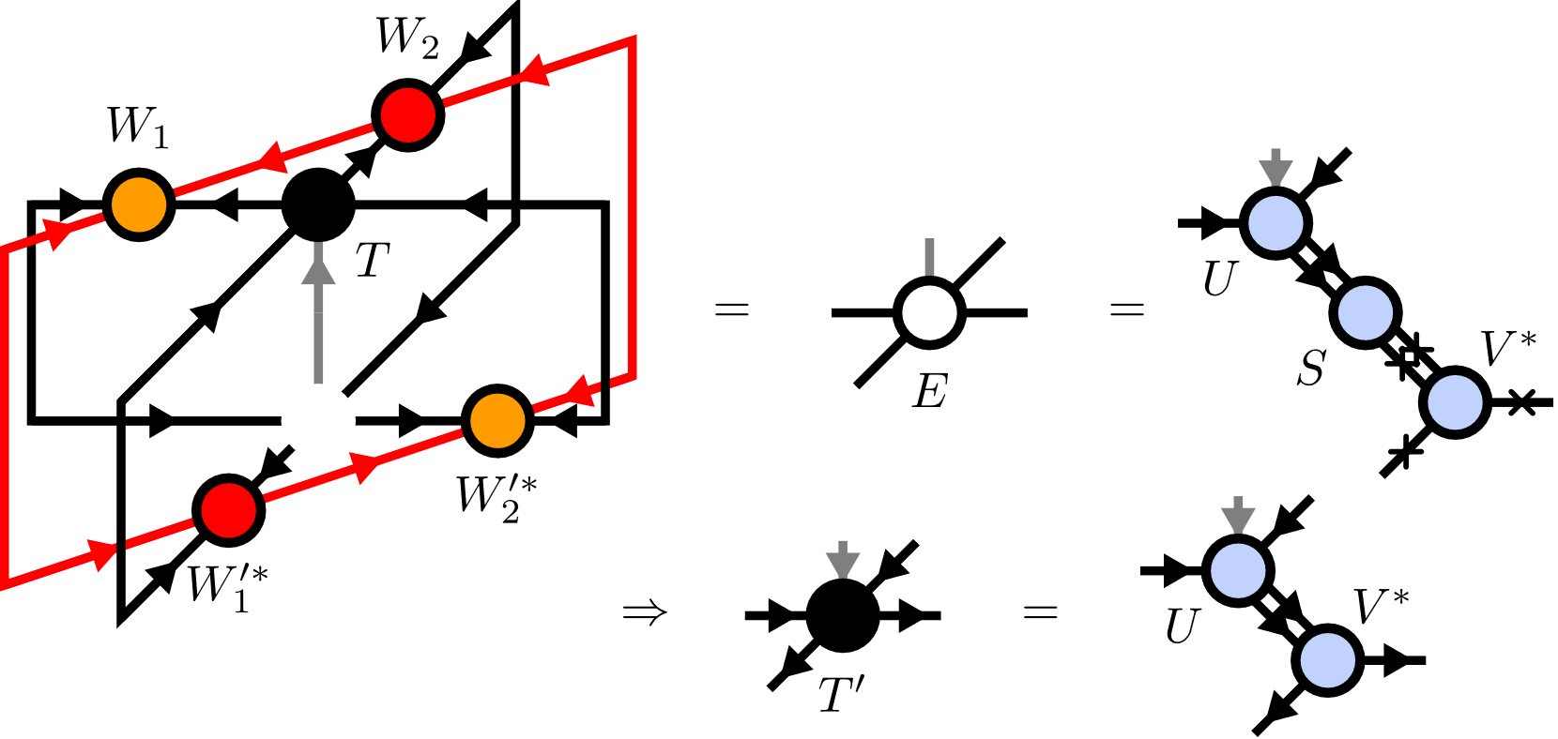
YB-move: Variational optimization

Slide 34

YB-move: Variational optimization

Slide 35

YB-move: Variational optimization

Slide 36

YB-move: Variational optimization

Slide 37



YB-move: Tripartite decomposition

Slide 38

Disentangling procedure

Slide 39



Disentangling procedure
Cost functions:
Truncation error
Renyi-entropy
with

Slide 40





Renyi-2 disentangling
maximize

Slide 41

Renyi-2 disentangling

Slide 42

Riemannian optimization
No easy tensor network form for cost functions
Use Riemannian optimization!

Slide 43



Riemannian optimization
CG:
TRM:

Slide 44

Approximate Gradients

Slide 45



Approximate Gradients
Gradients
CG/TRM

Slide 46

YB-move: Comparison

Slide 47


TEBD: Local updates
Apply local bond operator:
Maximization problem

Slide 48

TEBD: Local updates

Slide 49

TEBD1

Slide 50

TEBD2

Slide 51


Transverse Field Ising (TFI) model
Critical field

Slide 52




Comparing YB-move algorithms

Slide 53




Comparing YB-move algorithms

Slide 54




Comparing YB-move algorithms

Slide 55

Comparing YB-move algorithms

Slide 56



Comparing bond dimensions

Slide 57


TEBD1 vs TEBD2

Slide 58




Larger lattices

Slide 59

Larger lattices

Slide 60

Larger lattices

Slide 61

Real-time evolution: Global quench

Slide 62
Summary & Outlook
TODO
New canonical form
YB move scales worse than MM
Nevertheless YB-isoTPS are cool
Easy generalization: show Honeycomb
Outlook: DMRG, GPU, etc

